Slide 1
COMMONWEALTH OF AUSTRALIA
Copyright Regulations 1969
WARNING
This material has been reproduced and communicated to you by or on behalf of the SAE Institute Pty Ltd pursuant to Part VB of the Copyright Act 1968 (the Act).
The material in this communication may be subject to copyright under the Act. Any further reproduction or communication of this material by you may be the subject of copyright protection under the Act.
Do not remove this notice.

Slide 2

Unreal Engine 4
The Unreal Engine is a game engine developed by Epic Games released in May 1998.

Slide 3
Although primarily developed for first-person shooters, it has been successfully used in a variety of other genres, including: stealth, fighting games, MMORPGs, and other RPGs. With its code written in C++, the Unreal Engine features a high degree of portability and is a tool used by many game developers today.
UE also used in computer science, education, medical, art, architecture, simulation, and visualization programs.

Slide 4

Interactive architectural visualization - ArchViz

Slide 5
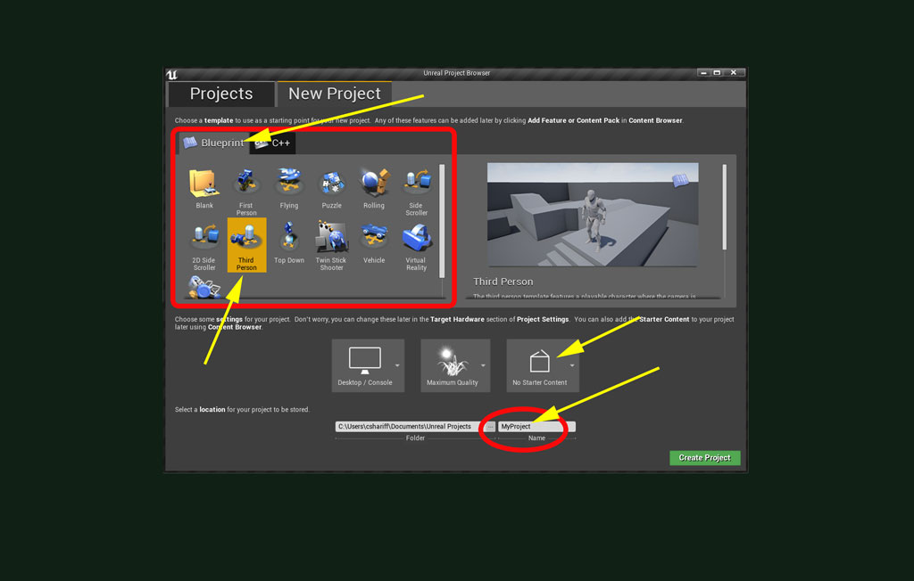
Open Epic Game Launcher and sign in and select Unreal Engine
Choose New Project as Blueprint --> Third Person

Slide 6
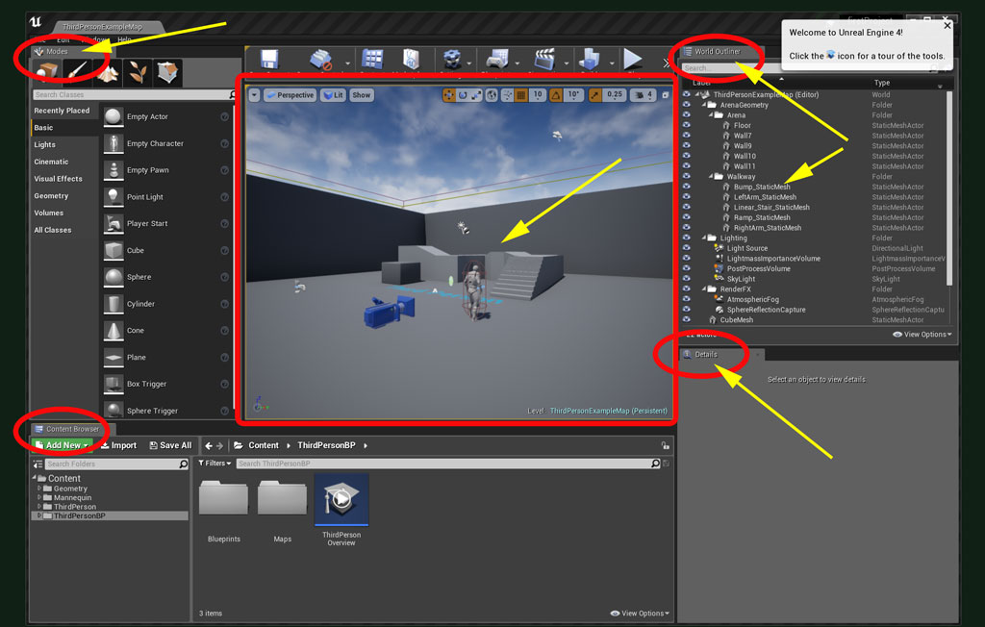
Check Modes, World Outliner, Details Also expand Content Browser and open “Output Log “

Slide 7
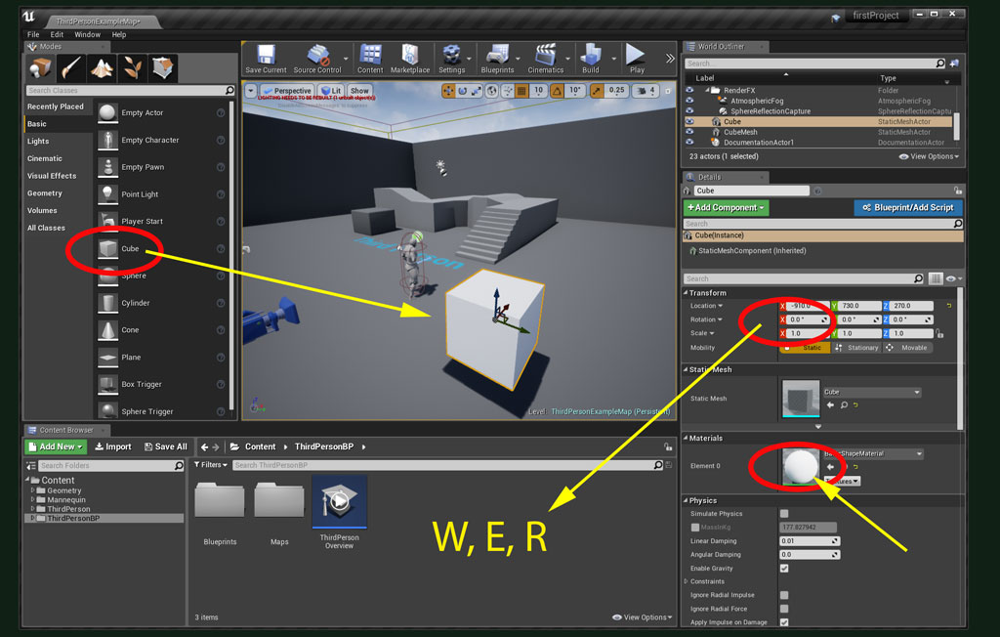
Drag and Drop ”Basic” cube object
Use W, E and R keys as shortcuts for transform object

Slide 8
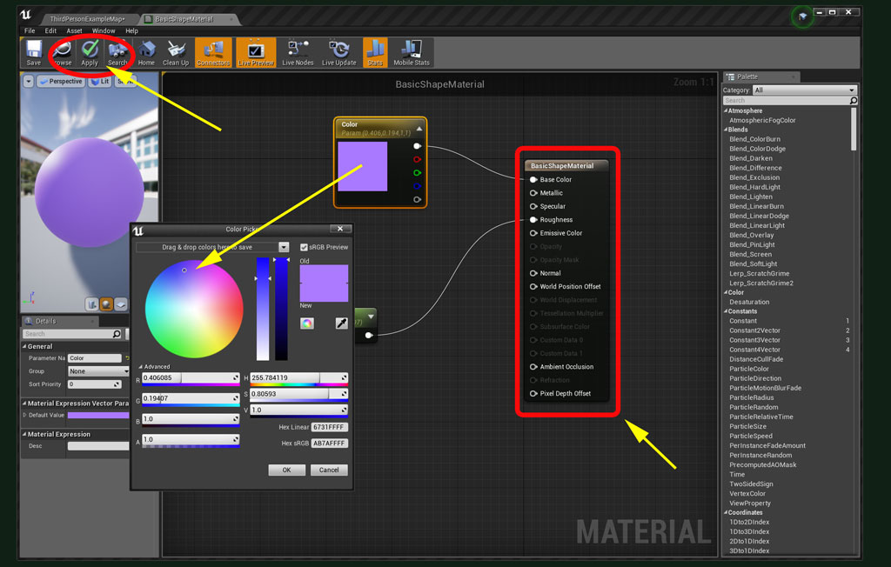
After click on material box, you will find material editor
Try simply change colour and apply

Slide 9
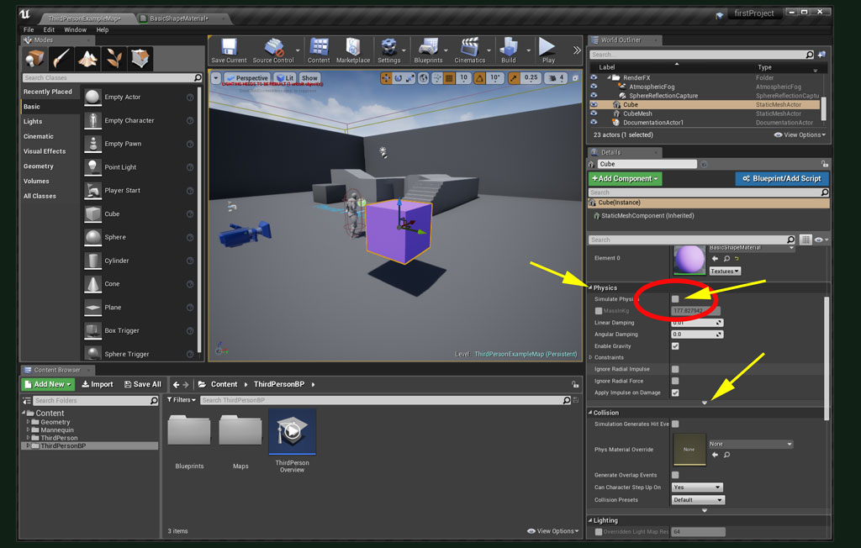
On Physics tab, apply physics and check effect by hit Play.
There are multiple options here related to Physics as well.

Slide 10
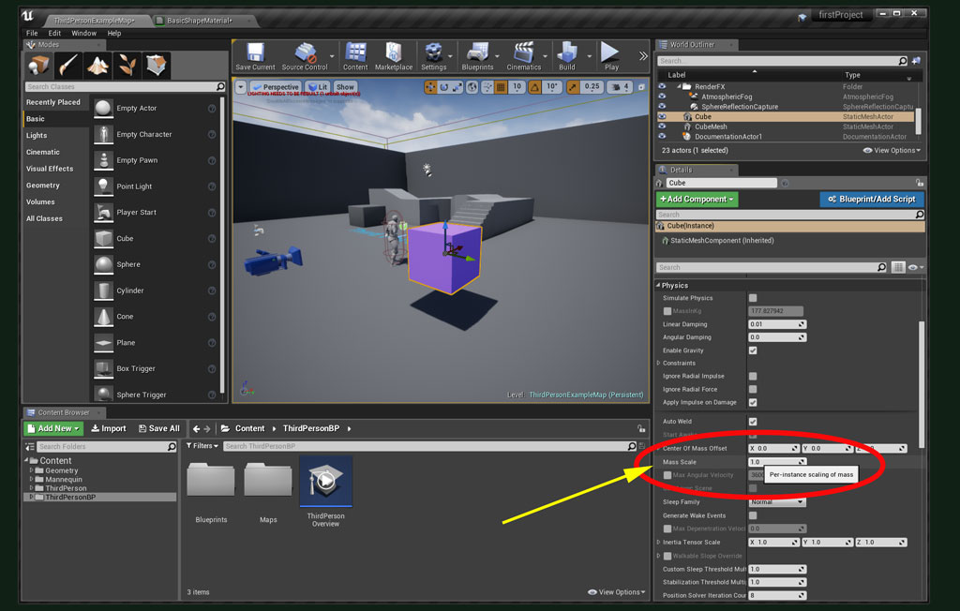
Change “Mass” with values like 10 and 5000,
then try to move object with your character on Play.

Slide 11
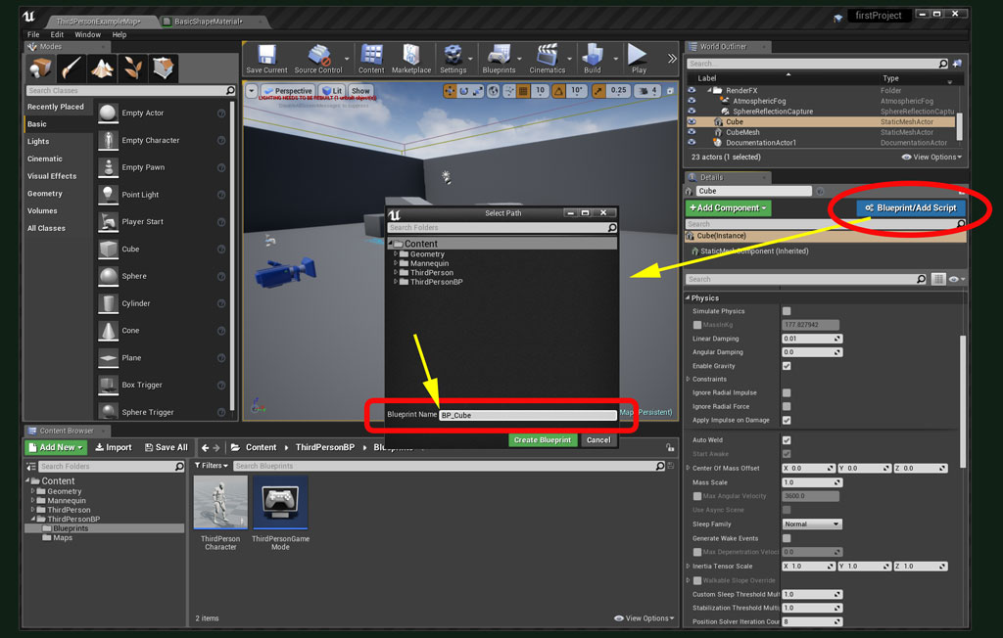
Now lets add some functionality to cube object by
adding BluePrint.

Slide 12
ALWAYS
USE
BP_[your preferred name]
on naming your Blueprint.
This is an industry standard.

Slide 13
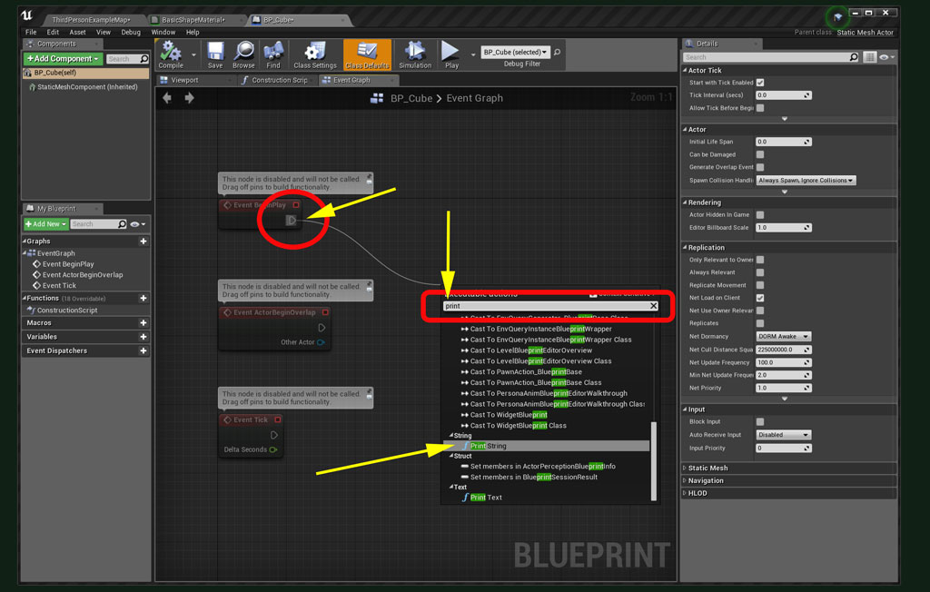
Use EventBeginPlay to show message on screen and Output log
by using “Print String” BP command

Slide 14
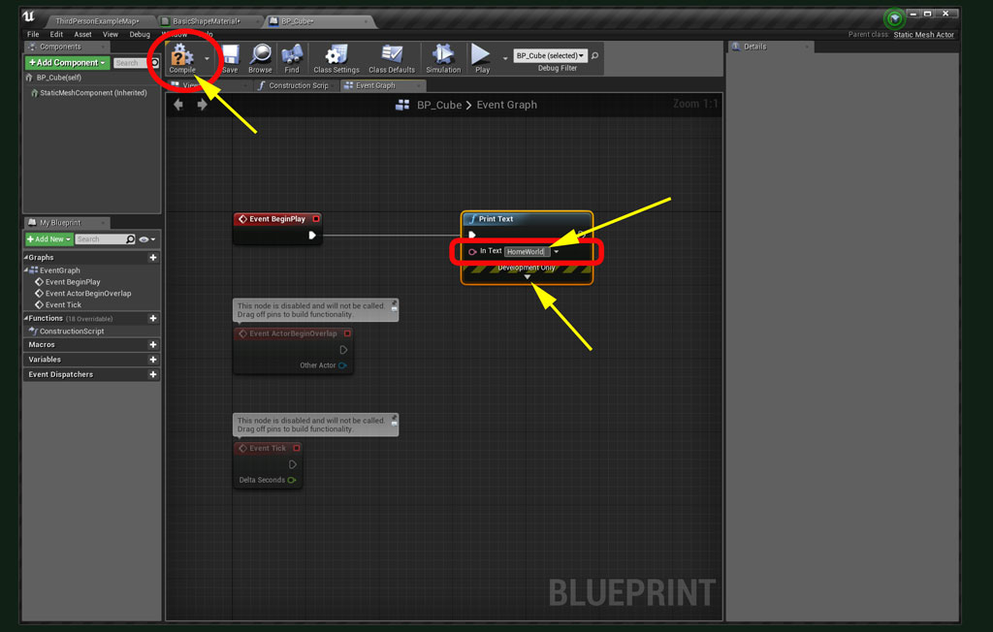
You need to push “Compile” after any change in blueprint, otherwise it doesn't work.

Slide 15
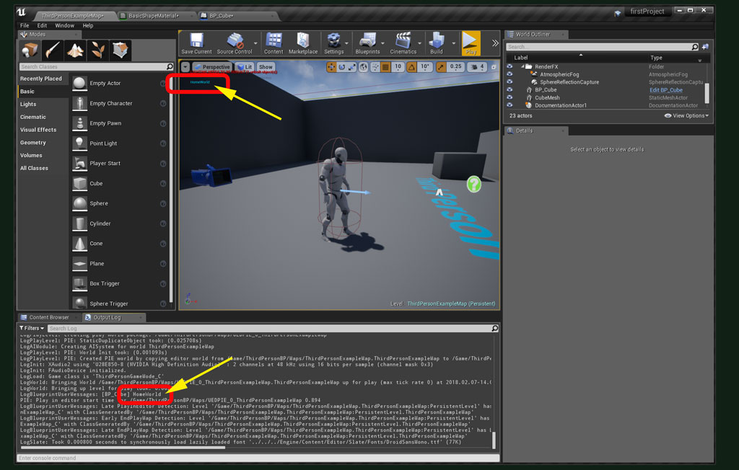
On play, the message will print on game screen and also in output log. Try to change colour and duration and test again.

Slide 16
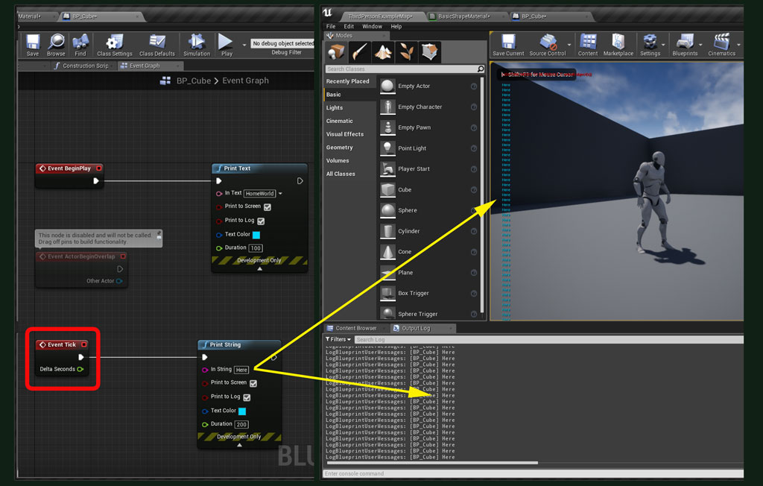
Check “EventTick” on print message.
This event, on each frame by default, will print your message.

Slide 17
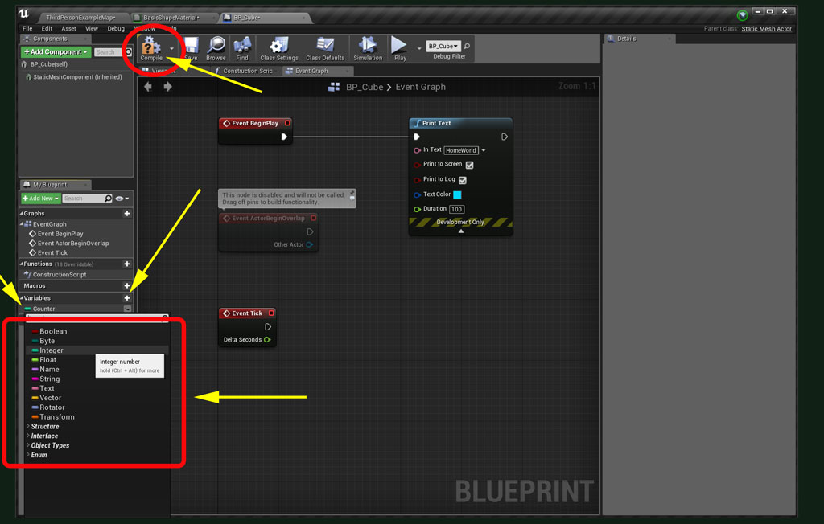
Variables in Blueprint have same variations like any other programming languages, but they are like “Visual Boxes”

Slide 18
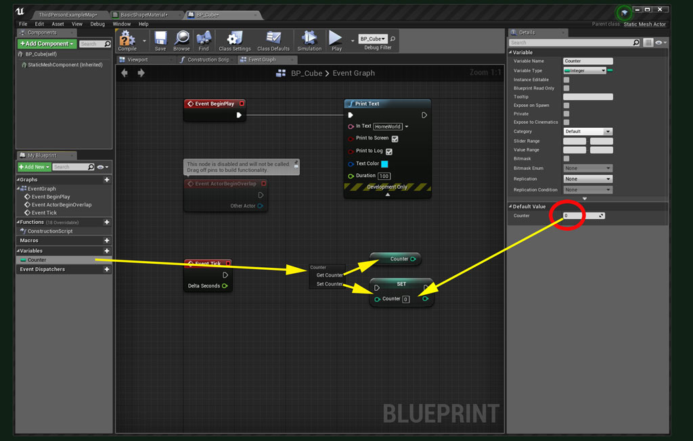
Each variable can be “Set” to a value and “Get” by other parts of your blueprint.

Slide 19
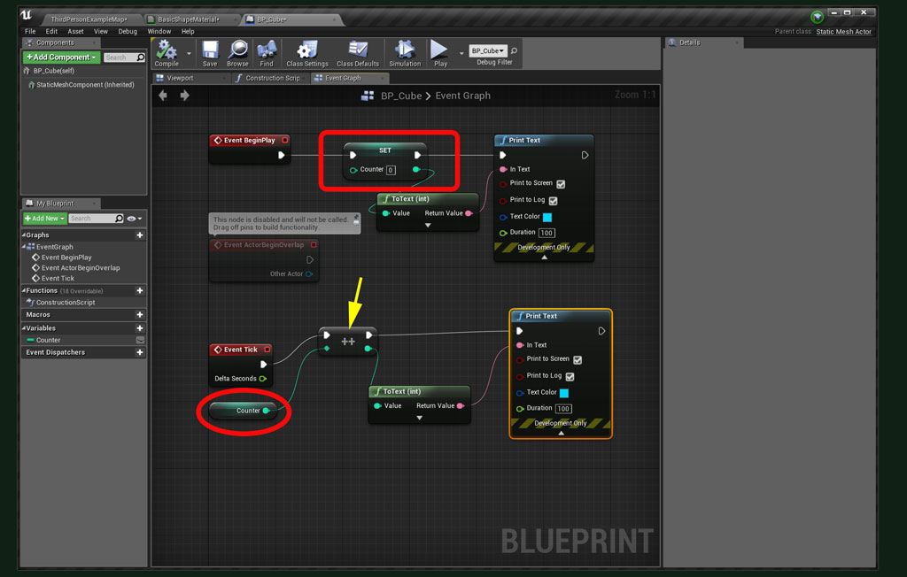
Simple example: Increment an integer variable by using “EventTick”

Slide 20
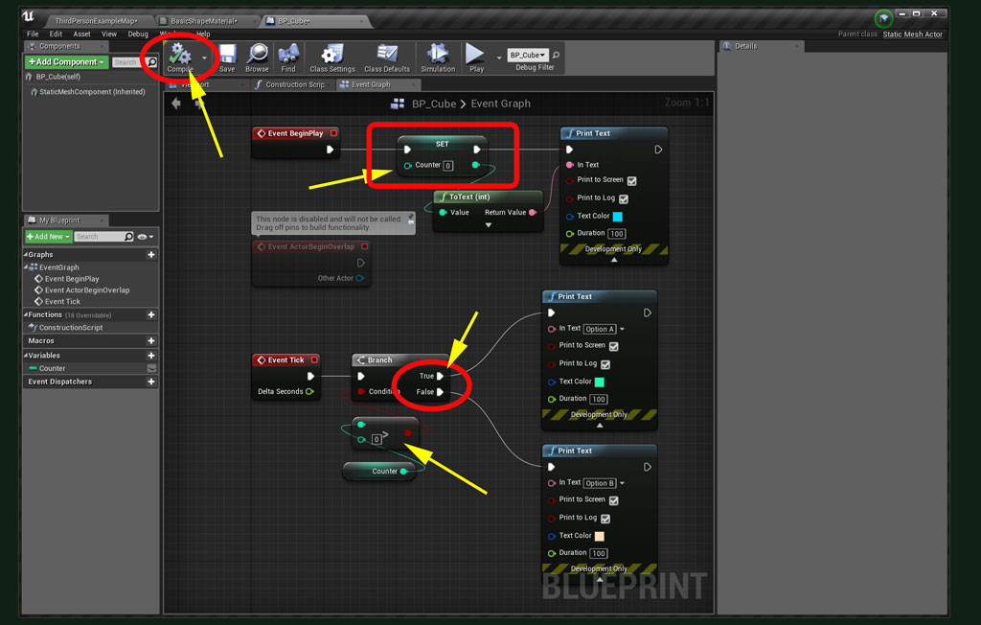
Simple example:
Using “Branch” to make an “IF” logical statement.

Slide 21
Links and Refrences: Unreal Engine 4 Documentation
https://docs.unrealengine.com/latest/INT/
AnswerHub
https://answers.unrealengine.com/index.html
Examples and practical tasks in BluePrint
Mathew Wadstein
in YouTube

